Slide 1


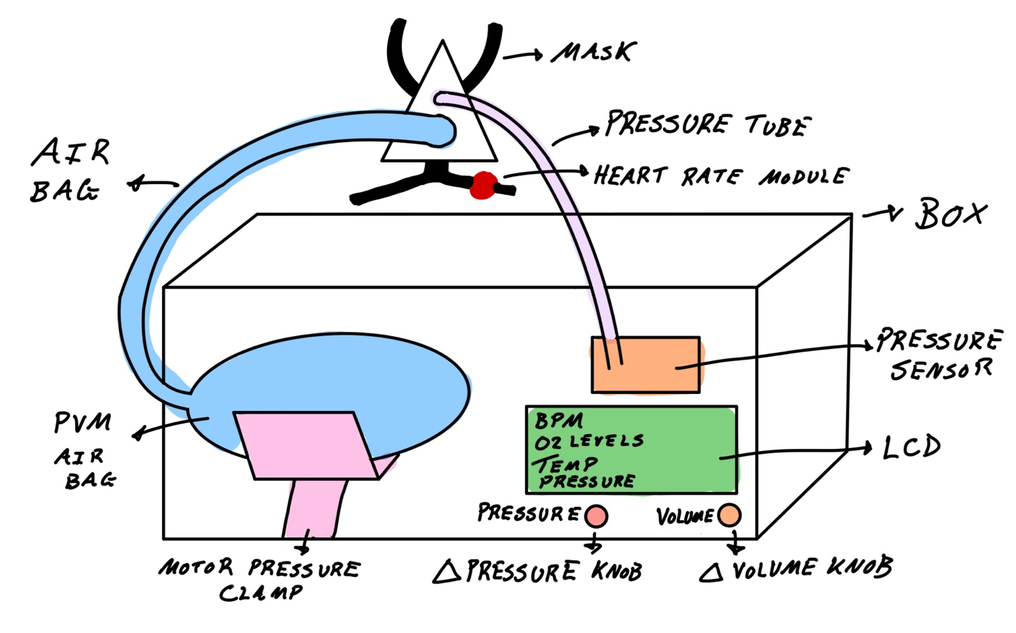
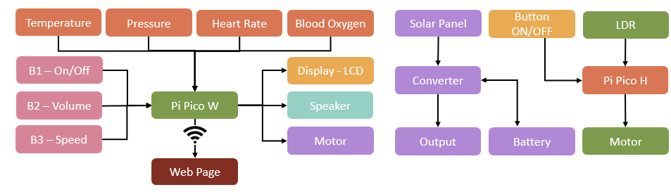
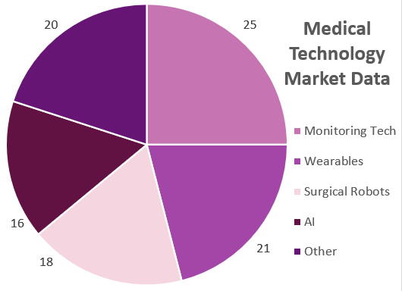
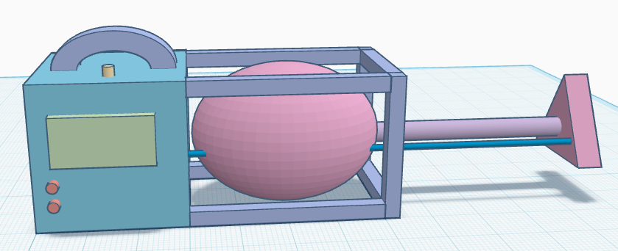
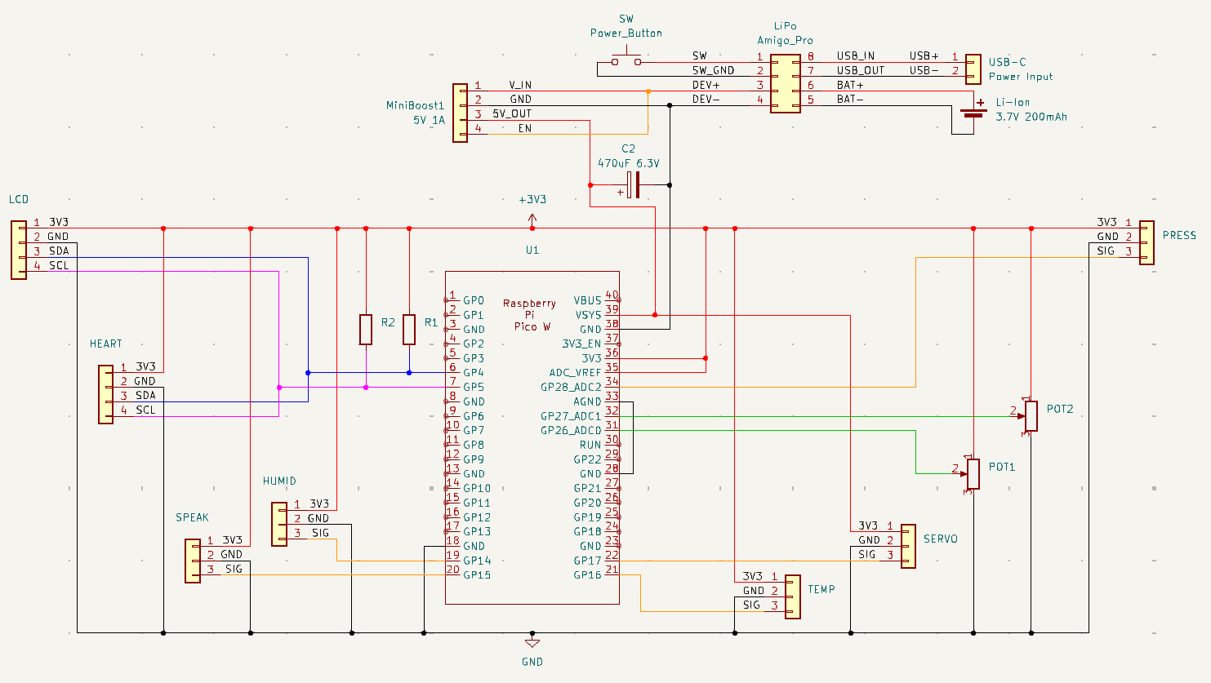
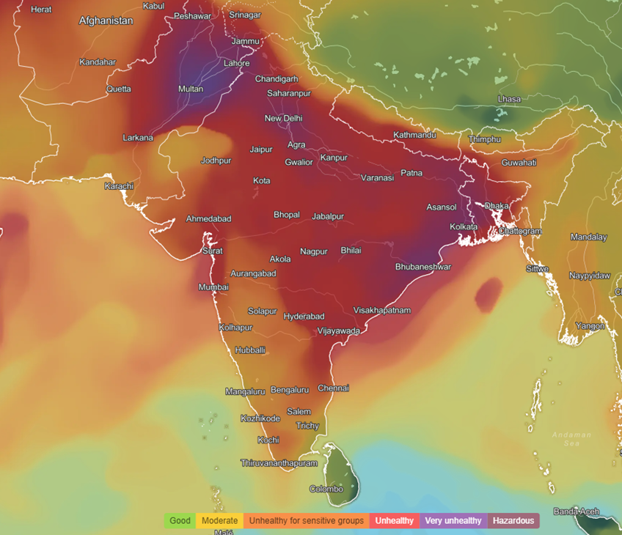
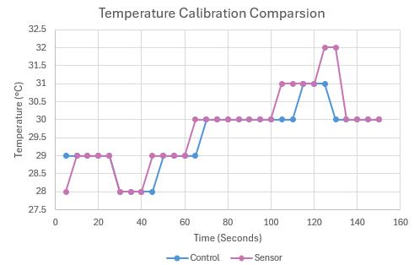
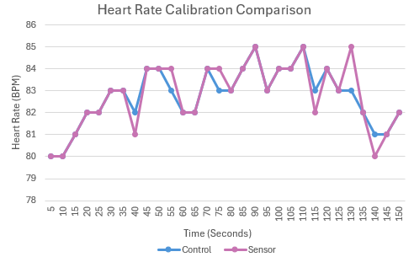
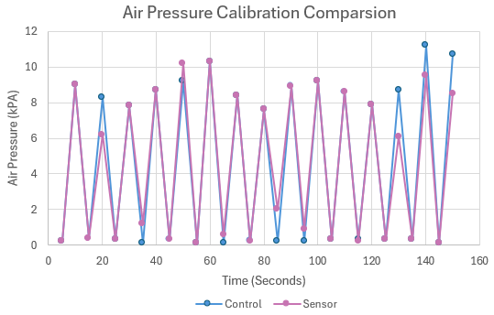
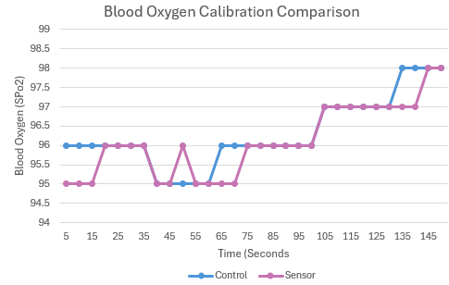
Smart Portable Vital Monitoring Ventilator with a Companion Webpage for Rural Healthcare
GitHub
Student: Muhammad Hamza Taher
ID: 201723236
Supervisor: Dr Munira Raja
Assessor: Dr Roberto Ferrero
Introduction
Background Information
This project aims to develop a system to remotely support health monitoring in rural South Asia via data transmission of vital data to nearby hospitals. [1]
Objectives include:
Utilising calibrated sensors to measure patient’s vitals
Display the patient’s vital data on an LCD and Webpage
Functional ventilator with adjustable setting (speed and pressure)
Rechargeable battery system for longer duration of use
Working alarm system activated when thresholds are exceeded
The design (in Fig. 1) incorporates the following features:
Pico W to detect patients vitals to display on an LCD and webpage for remote monitoring [2]
Potentiometer-controlled motor acts as an adjustable ventilator [3]
Rechargeable battery and alarm system.
Fig. 1: Initial Sketch
Specification
Implementation and Design
Market Research
The system is a monitoring aid, not a replacement for professional equipment [6].
Future updates includes data encryption and compliance with medical standards (Fig.6)
Design specifications are as follows:
Heart Rate accuracy: ± 5 BPM
Web latency: 15ms
Battery duration: 20 Hours
Alarm trigger success: 90%
The Pico W splits its attention between the motor, LCD, webpage, and sessors to manage signals to stop starvation for a cost-effective design [4].
For areas with low access to power, a solar tracker was designed to track the sun to convert solar energy to a stable 5V output (in Fig.4) [5].
Estimated to grow to $712.9 bn by 2030, the medical technology market is a fast-growing industry with IoT monitoring devices at the highest market share of 25%,(in Fig.2) reaching $40.7 bn by 2030 [7]
Fig. 4: Block Diagram of Ventilator and Solar Tracker
The KiCAD schematic (in Fig.5) shows a shared 3.3V input and ground with i2C signal pins connecting to a Pico pin. The rechargeable LIPO battery uses a power sub-circuit and direct connection to the servo. Controlled by an ON/OFF button with the device booting until connected to WIFI.
Fig. 2: Market Data of Medical Data
Fig. 6: 3D Mock Up of Design
Rural areas in South Asia have high levels of chronic respiratory diseases resulting in 12% of deaths across all regions [8]. Paired with low medical access results in high mortality rates.
References
Webster, J. (2017). Medical Instrumentation: Application and Design.
Analog Devices (2019). MAX30102 Pulse Oximeter and Heart-Rate Sensor Datasheet.
Just Do Electronics (2022). DIY Ventilator Using Arduino.
Raspberry Pi Foundation (2021). Getting Started with Raspberry Pi Pico.
Circuit Digest (2020). Sun Tracking Solar Panel Using Arduino
World Health Organization (2019). Technical Specifications for Medical Devices.
Nagarro (2024). Medical Devices Market Summary
IQAir (2024). Global Air Quality Map
Fig. 5: Ventilator System Schematic
Fig. 3: Air Pollution in South Asia
Sensor Calibration Results and Discussion
Conclusion
Temperature:
Figure 8 shows
Calibrated against:
Thermometer
Adjusted using:
Code Libraries
Issues came from:
refresh rate adjustment
Heart Rate:
Figure 7 shows
Calibrated against:
Apple Watch
Adjusted using:
Code Libraries
Issues came from:
Adjustments for darker skin
The project was an overall success as the aims were met through the following objectives:
Responsive data displays
Calibrated sensors for vital reading
Adjustable functional ventilator
Alarm system active when exceeded thresholds
Further improvements include:
Larger battery capacity for longer time of usage
Longer transmission range for instant medical data refresh rate
Global patient database with encryption data
Added sensors like ECG for better scope of information
Air Pressure:
Figure 9 shows
Calibrated against:
Medical tool
Adjusted using:
Code Libraries
Issues came from:
Tube leakages and diameter
Fig. 8: Temperature Calibration Graph
Fig. 7: Heart Rate Calibration Graph
Blood Oxygen:
Figure 10 shows
Calibrated against:
Apple Watch
Adjusted using:
Code Libraries
Issues came from:
Adjustments for darker skin
Fig. 9: Air Pressure Calibration Graph
Fig. 10: Blood Oxygen Calibration Graph

